Slide 1

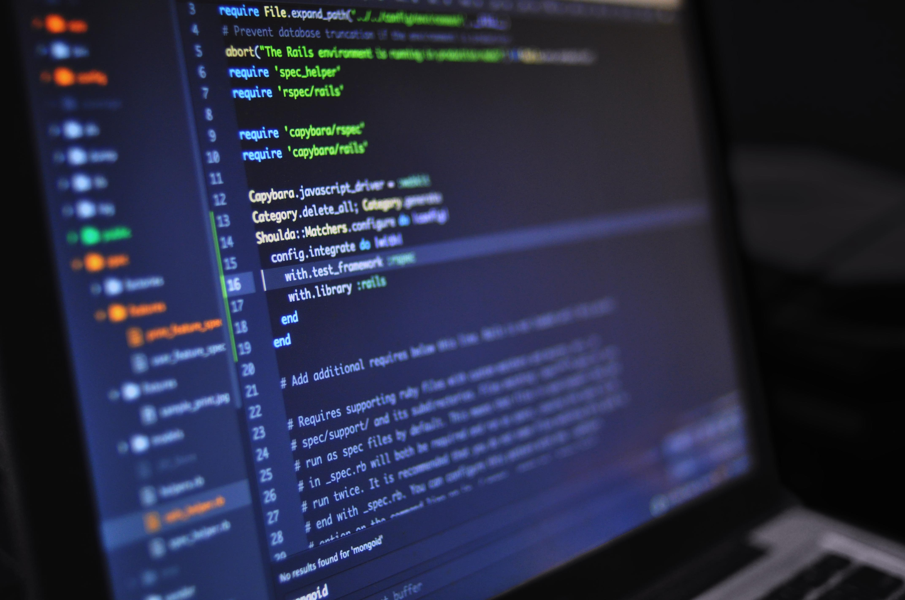


Lesson 03:
Exceptions and error handling
File handling
Libraries (NumPy, …)
Regular expressions
Data visualization
GUI creation (Tkinter, PyQt/PySide, Figma)
Dealing with data frames (reading, cleaning & presenting)
Introduction to machine learning
Python for beginners
with applications
Write code from scratch in a clear & concise way, through a complete basic course.
From beginners to intermediate.
https://github.com/Abdou-fi/python/tree/main/2025-2026/Course_03
Abdesselam Filali 2026-01-01 18h00 Algiers time

